Slide 1
Bankruptcy Prediction using Machine Learning
Submitted by: Murtaza Kanchwala

Slide 2
Contents
Introduction
Significance of Bankruptcy prediction
Project AIM
Dataset
Project Pipeline
Data Quality Assessment
Data Preparation
Analysis about Financial Ratios
Modelling Pipeline
Model Evaluation

Slide 3
Introduction
Bankruptcy:Bankruptcy is a legal proceeding initiated when a person or business cannot repay outstanding debts or obligations. It offers a fresh start for people who can no longer afford to pay their bills.
Bankruptcy Prediction: Bankruptcy prediction is the problem of detecting financial distress in businesses which will lead to eventual bankruptcy. Machine Learning methods are increasingly being used for bankruptcy prediction using financial ratios. Machine Learning models can outperform classical statistical models by a significant margin in bankruptcy prediction.

Slide 4
Significance of Bankruptcy Prediction
Bankruptcy prediction is an important for modern economies because early warnings of bankrupt help not only the investor but also public policy makers to take proactive steps to minimize the impact of bankruptcies. The reasons that add to the significance of bankruptcy prediction are as follows:
Better allocation of resources
Input to policy makers
Corrective action for business managers
Identification of sector wide problems
Signal to Investors
Relation to adjacent problems

Slide 5
Project AIM
The aim of this project is to use machine learning algorithms, and aim to analyze various financial attributes and build a predictive model that can classify companies as either financially healthy or at risk of bankruptcy.

Slide 6
Data Structure
There are a total of 94 Features in the dataset. Based on the data we have following information about Target variable:
Total No of Records | No. of Bankrupt Instances | No. of Non-Bankrupt instances
6819 | 220 | 6599

Slide 7
Project Pipeline
Import and understand the bankruptcy data
See if the data has any shortcomings like missing data or data imbalance, and fix them
Perform Data Analysis to get important insights form it
Develop predictive models using various machine learning algorithms
Evaluate the performance of the models using various metrics

Slide 8
Data Quality Assessment
Null Values Check
Goals
Class Imbalance check
Outlier Check

Slide 9
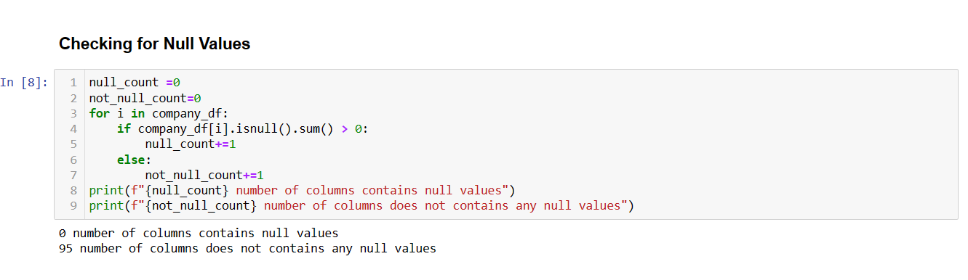
Null Values Check
The given dataset doesn’t contains any Null values

Slide 10
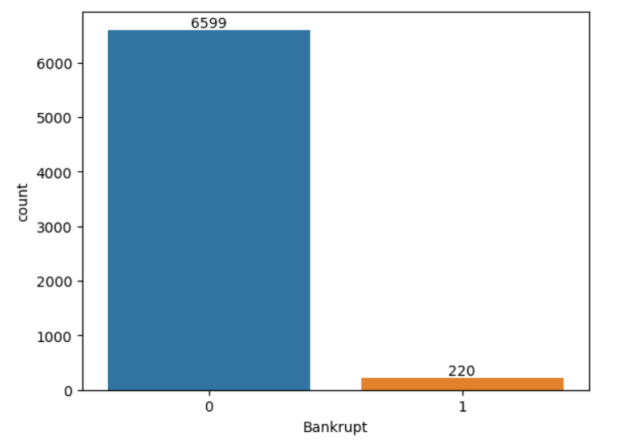
Target Class Imbalance Check
The dataset has huge class imbalance. The values belonging to the minority class is only 3.226%. To deal with this class imbalance we have used SMOTE technique.
The class ‘0’ (zero) represents the instances of Non-Bankruptcy & class ‘1’ (one) represents the instances of Bankruptcy.
Graph shows the class imbalance

Slide 11
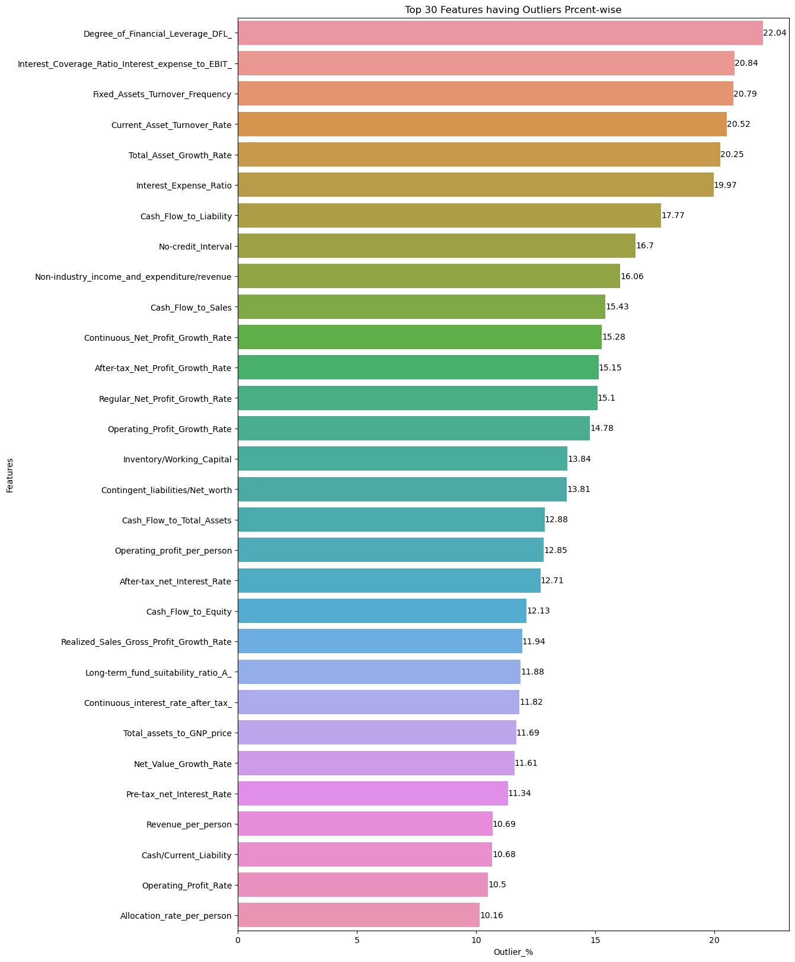
Outlier Check
We create a function in python for checking the outliers in the dataset. The graph below represents the Percentage of outliers in top 30 features.

Slide 12
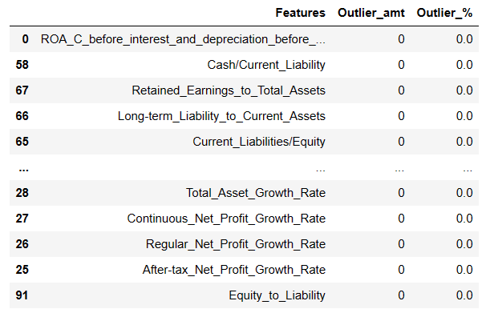
Data Preparation
1) Dealing with the Outliers:
Create a function which imputes:
Values greater than Upper Limit with Upper Limit
Values lesser than Lower Limit with Lower Limit

Slide 13
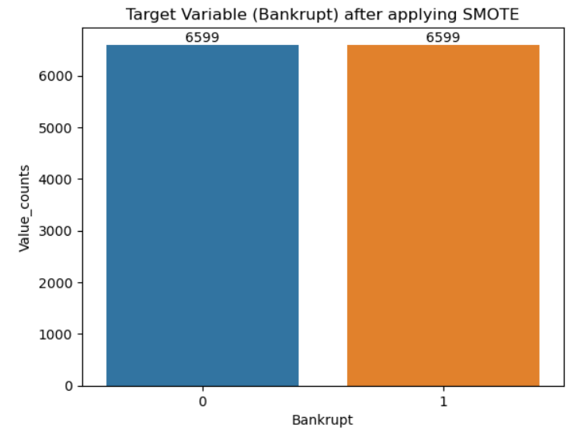
2) Dealing with the Class Imbalance:
SMOTE Oversampling

Slide 14
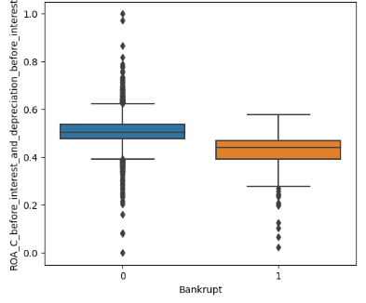
Analysis about Financial Ratios
ROA (C) before interest and depreciation before interest:
It measures a company’s earnings before interest and taxes (EBIT) relative to its total net assets. Keep in mind that the ideal ROA can vary by industry, but a stable and healthy organization typically aims for a minimum ROA that exceeds its cost of capital and reflects efficient asset utilization.
Graph shows that Financially heathy companies have ‘ROA (C) before interest and depreciation before interest’, higher than that of companies which are at the risk of Bankruptcy.

Slide 15
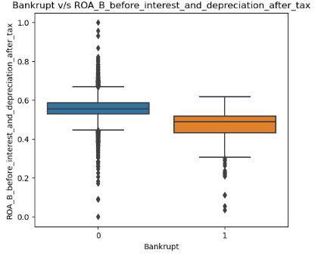
ROA before interest and depreciation after tax:
After-tax return on assets (ROA) is a financial ratio used to measure after-tax income earned by a company from its assets.
A company's ROA shows how efficiently a company's assets earn income. A higher ROA illustrates that a company's assets are earning more money. Broadly speaking, an ROA of 5% or under is considered low and an ROA of 20% or higher is considered very good.
Box plot shows ROA after tax of healthy companies are higher than the companies which are at the risk of bankruptcy.

Slide 16
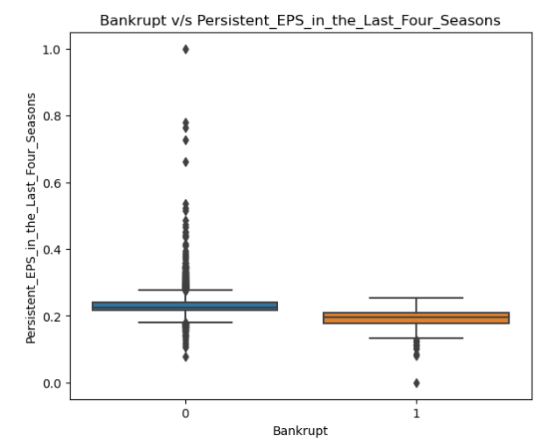
Operating Expense Rate:
The operating expense ratio measures a company's operating expenses as a percentage of its net sales. This key financial metric provides insight into a company's operational efficiency and profitability. A lower OER is more desirable for investors because it indicates that expenses are minimized relative to revenue. Ideally, the OER should fall between 60% and 80%, with lower values being preferable. The formula for calculating operating expense ratio is:
Operating Expense Ratio = (Operating Expenses / Net Sales) x 100
Persistent EPS in the Last Four Seasons:
Earnings per share is one of the most important metrics employed when determining a firm's profitability on an absolute basis.
Boxplot shows that the companies which are financially healthy are having higher rate of Persistent EPS in the Last Four Seasons than that of the companies which are at the risk of bankruptcy.

Slide 17
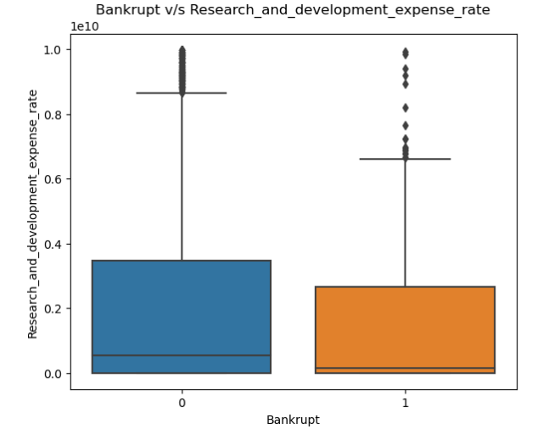
Research & Development Expense Rate:
The R&D Expense Ratio is a measure of the amount of money a company spends on research and development relative to its overall revenue. It is calculated by dividing the company’s R&D expenses by its total revenue.
The R&D Expense Ratio is an important metric that reflects a company’s commitment to innovation and growth. A high R&D Expense Ratio shows that a company is willing to invest in its future, while a low R&D Expense Ratio may indicate a lack of commitment or resources for innovation. This can impact a company’s ability to stay competitive in the long run.
Technology companies tend to have higher R&D Expense Ratios than retail companies. According to data from FactSet, the average R&D Expense Ratio for technology companies in the S&P 500 is around 13%, while the average for retail companies is about 3%. However, it is important to remember that benchmarks vary greatly by industry and by company size, so it is important to compare apples to apples.
Fig shows that the R&D expense rate for financially healthy companies are significantly higher than that of Bankrupt companies

Slide 18
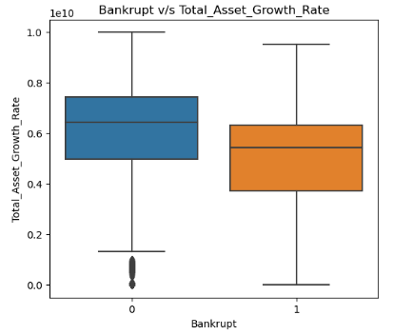
Cash Reinvestment Ratio:
Cash reinvestment ratio is a valuation metric that measures the percentage of annual cash flow that the company invests back into the business. A high ratio implies that the company has the potential for significant growth and expansion in the future, signaling efficient operations. A low ratio suggests that the company is stable in its activities and probably has grown to its full capacity. A good cash reinvestment ratio can vary depending on the industry and stage of growth of the company. Generally, a ratio above 50% is considered good.
Total Asset Growth Rate:
The Asset Growth Rate shows how quickly a company has been growing its Assets. It is calculated as a percentage change in Assets over a given period.
Box plot shows that the companies belonging to the Non-Bankrupt category have higher Asset Growth Rate and companies at the risk of bankruptcy have lower Asset Growth Rate.

Slide 19
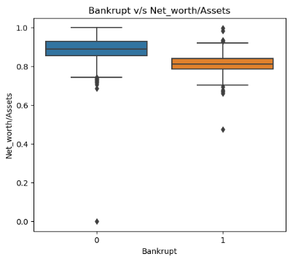
Net worth/Assets Ratio:
The net worth ratio is a financial ratio that measures a company’s financial performance, solvency, and asset utilization.
The Box plot shows that companies belonging to the Non-Bankrupt category have higher Net Worth ratio and companies belonging to the Bankrupt category have lower Net worth ratio.
Current asset/Liability Ratio :
The current asset/liability ratio, also known as the working capital ratio, is a measure of a business's capability to meet its short-term obligations that are due within a year. It is calculated by dividing current assets by current liabilities. A good current ratio is typically considered to be anywhere between 1.5 and 3.

Slide 20
Quick Ratio:
The Quick Ratio, also known as the Acid-test or Liquidity ratio, measures the ability of a business to pay its short-term liabilities by having assets that are readily convertible into cash. These assets are, namely, cash, marketable, securities and account receivable. The higher the quick ratio, the better a company's liquidity and financial health. A company with a quick ratio of 1 and above has enough liquid assets to fully cover its debts.
.
The Quick Ratio Formula:
Quick Ratio = [Cash & equivalents + marketable securities + accounts receivable] / Current liabilities
Interest expense Ratio:
Interest expense ratio is a measure of how much interest a company pays on its debt relative to its income or assets. The lower the Interest-Expense ratio percentage, the stronger the ratio. A business or farm should be no higher than 5% to be considered strong.
The Interest expense ratio Formula:
Interest expense ratio = Interest expense / Gross Income

Slide 21
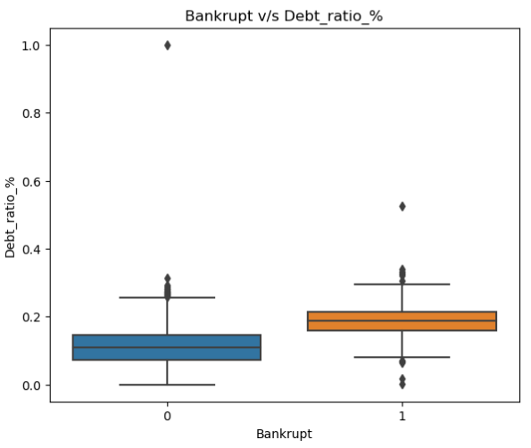
Debt Ratio :
The debt ratio is the ratio of a company's debts to its assets arrived at by dividing the sum of all its liabilities by the sum of all its assets. The debt ratio is a measurement of how much of a company's assets are financed by debt; in other words, its financial leverage.
If the ratio is above 1, it shows that a company has more debts than assets, and may be at a greater risk of default. A debt ratio of 0.4 or below is considered better than a ratio of 0.6 and higher.
The Box plot shows that the companies belonging to the Non-Bankrupt category have higher Net Worth ratio and companies belonging to the Bankrupt category have lower Net worth ratio.

Slide 22
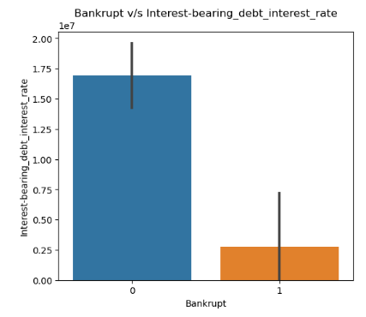
Cash Ratio :
The cash ratio is a measurement of a company's liquidity. It specifically calculates the ratio of a company's total cash and cash equivalents to its current liabilities. The metric evaluates company's ability to repay its short-term debt with cash or near-cash resources.
A ratio above 1 is generally favored, while a ratio under 0.5 is considered risky as the entity has twice as much short-term debt compared to cash. The formula for a company's cash ratio is:
[Cash Ratio: Cash + Cash Equivalents / Current Liabilities]
Interest-bearing Debt Interest Rate:
It refers to the percentage of interest a lender charges for a loan as well as the percentage of interest earned on an interest-bearing account or security
The graphical analysis shows that the companies belonging to the Non-Bankrupt category have higher Interest-bearing Debt Interest Rate and companies belonging to the Bankrupt category have lower Interest-bearing Debt Interest Rate.

Slide 23
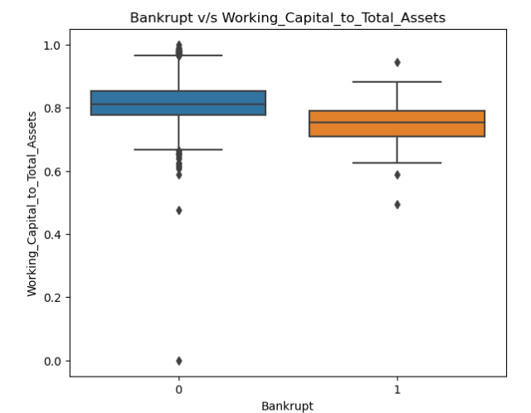
Working Capital to Total Assets ratio :
The Working Capital to Total Assets ratio measures a company’s ability to cover its short term financial obligations (Total Current Liabilities) by comparing its Total Current Assets to its Total Assets. This ratio can provide some insight as to the liquidity of the company, since this ratio can uncover the percentage of remaining liquid assets (with Total Current Liabilities subtracted out) compared to the company’s Total Assets.
A good working capital ratio generally falls between 1.2 to 2.0. If a company’s working capital ratio is less than 1, it could indicate cash flow problems, not enough cash to cover future expenses. i.e. higher the ratio is less the chances of default.
The Box plot shows that the companies belonging to the Non-Bankrupt category have higher Working Capital to Total Assets ratio and companies belonging to the Bankrupt category have lower Working Capital to Total Assets

Slide 24
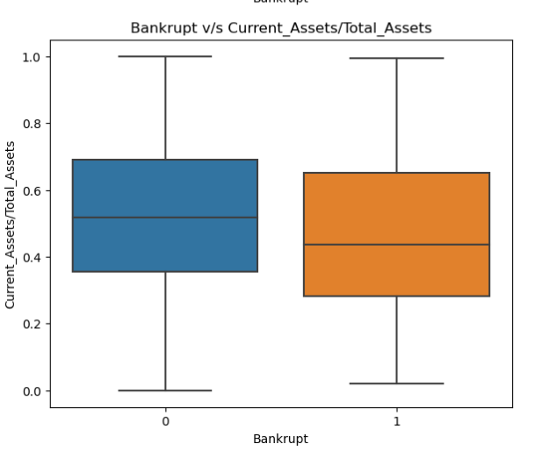
Current Assets to Total Assets Ratio (CATA) :
The Current Assets to Total Assets Ratio (CATA) is a financial metric that sheds light on a company’s ability to effectively utilize its assets to generate revenue and profit. This ratio indicates the extent to which total funds are allocated to working capital.
The Fig shows that the companies belonging to the Non-Bankrupt category have higher Current Assets to Total Assets Ratio (CATA) and companies belonging to the Bankrupt category have lower Current Assets to Total Assets Ratio (CATA)
Cash to Total Assets Ratio :
The cash to total assets ratio is a measure of the proportion of a company's assets that are made up of cash and short term investments. It is calculated as cash divided by total assets.
A good cash to total assets ratio would be 1. This indicates that a company is able to pay off its short-term obligations with its most liquid assets.

Slide 25
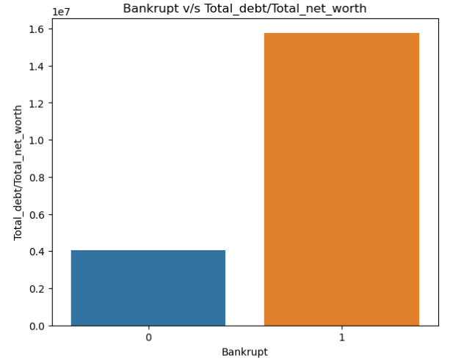
Long-term Liability To Current Assets Ratio:
The long-term liability to current assets ratio is a financial metric that provides insights into a company’s ability to cover its short-term obligations using its current assets. The long-term liability to current assets ratio plays a crucial role in evaluating a company’s short-term liquidity and financial stability
Total Debt/Total Net Worth:
The debt to net worth ratio is a financial metric used in comparing the level of debt of a company with its net worth. It is an indication of the financial health of a company. A ratio above 100% is not good as it means that the company cannot use its assets to pay off its debt. A ratio below 100% means that a company can use its assets to settle its debt.
The Graph shows that the companies belonging to the Non-Bankrupt category have lower Total Debt/Total Net Worth and companies belonging to the Bankrupt category have higher Total Debt/Total Net Worth

Slide 26
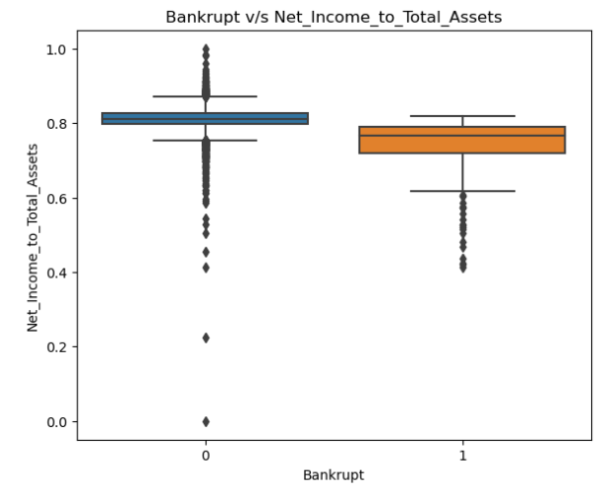
Profit Per Person:
The term profit per person refers to a metric that evaluates the efficient use of personnel. Profit per person is particularly useful for companies that have a relatively high proportion of labor expenses. This metric provides insights into how effectively your workforce contributes to the company’s financial success. Higher profit per employee generally indicates better efficiency and productivity.
The Profit Per Person Formula:
Profit Per Person = Net Profit / No. of Employees
Net income to total assets :
Net income to total assets is a financial ratio used to measure a company's profitability and efficiency in using its assets to generate earnings. It is also known as return on total assets (ROTA) or return on assets (ROA). A higher ROTA indicates more efficient asset utilization. When ROTA is 1 (or 100%), the company earns a new dollar for each dollar invested.
The Fig shows that the companies belonging to the Non-Bankrupt category have higher whereas companies belonging to the Bankrupt category have lower Net income to total assets rate.

Slide 27
Liabilities to Equity Ratio :
The Liabilities to Equity Ratio is a financial metric that assesses a company's financial leverage by comparing its total liabilities to its shareholders' equity. It's an indicator of how a company is financing its operations and growth - whether it's through debt (liabilities) or its own funds (equity). A good liability-to-equity ratio is generally considered to be around 2 or 2.5
The Liabilities to Equity Ratio Formula:
Liabilities to Equity Ratio = Total Liabilities/ Stockholder's Equity
Degree of Financial Leverage (DFL) Ratio :
It shows how much a percentage change in EBIT will result in a percentage change in EPS. DFL is an important metric for investors and analysts to assess a company's financial risk and understand how changes in operating performance can affect its profitability. A higher DFL indicates a greater proportion of debt financing, which implies higher financial risk. Conversely, a lower DFL means that the company is largely operating on equity, implying lower financial risk.
The Degree of Financial Leverage (DFL) Ratio Formula:
DFL = % Change in EPS / % Change in EBIT

Slide 28
Modelling Pipeline
94 Features & 6819 Records
Dataset
Data Pre-Processing
Outliers removal
Correlation
Model Building
Without using SMOTE technique on dataset
Using SMOTE technique on dataset
Decision Tree
Random Forest
Logistic Regg
SVM
KNN
Naïve Bayes
XG Boost
Voting
Stacking
Evaluation

Slide 29
Models Evaluation
We have used F1- Score metric for evaluating the models because of lesser minority class presence the accuracy of all the models were above 92%. So to determine best predictive model we use F1-Score as a evaluation metric. We have created same models in two ways:
With the Class Imbalance i.e. without using SMOTE method on dataset.
Without the Class Imbalance i.e. using SMOTE method on dataset.

Slide 30
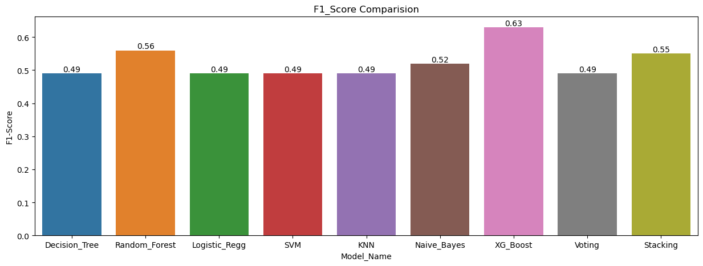
With the Class Imbalance i.e. without using SMOTE method on dataset.
The highest F1-Score is given by XG Boost classifier (63%) followed by Random Forest Classifier (56%) and Stacking Classifier (55%). All other models except Naïve Bayes Classifier (52%) gives F1-Score below 50%.

Slide 31
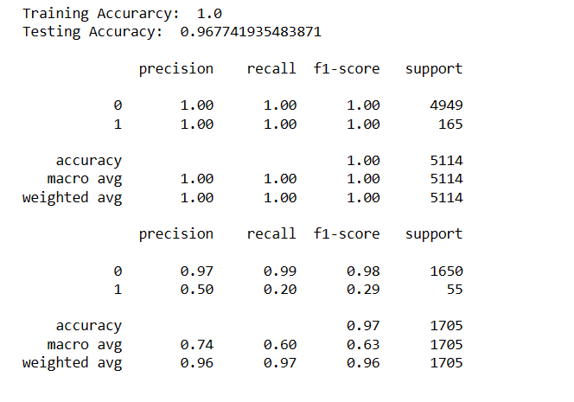
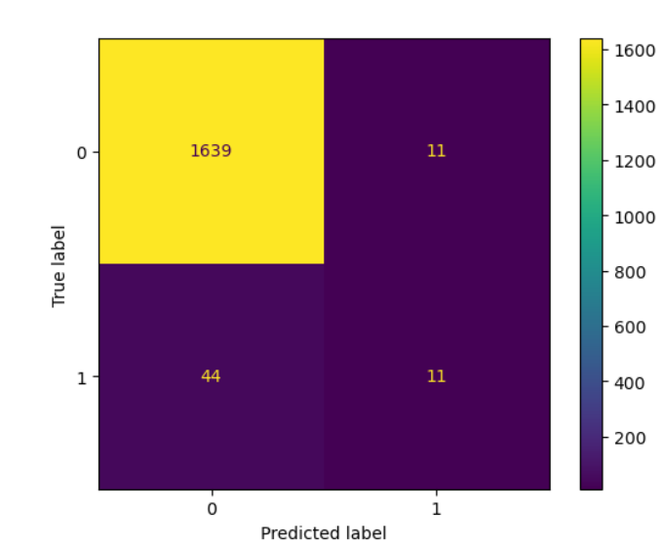
Results other than F1-Score given by XG-Boost Classifier on Imbalanced Dataset

Slide 32
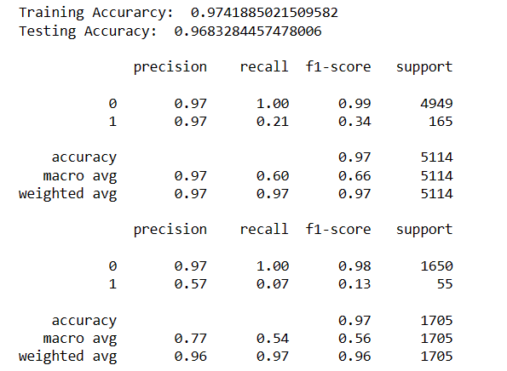
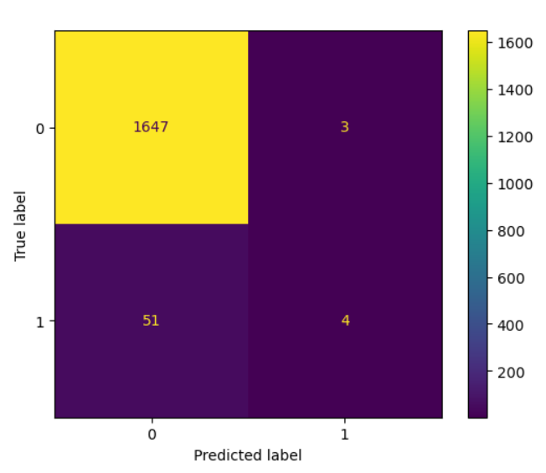
Results other than F1-Score given by Random Forest Classifier on Imbalanced Dataset

Slide 33
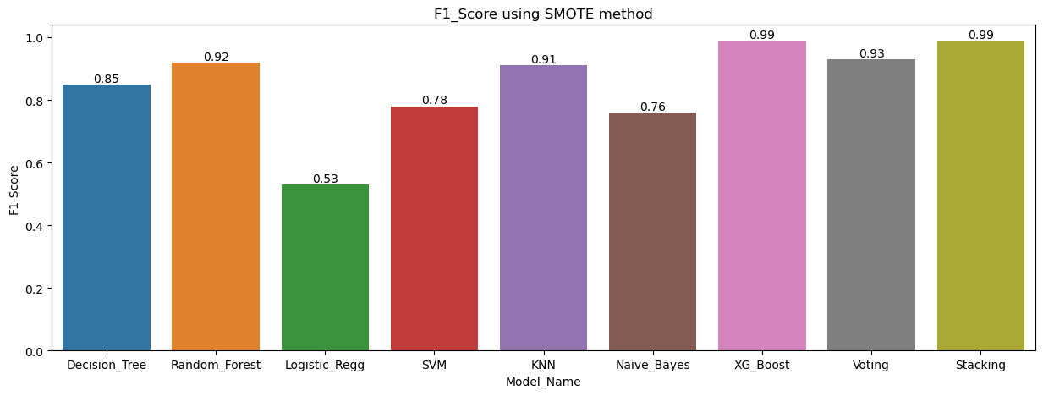
Without the Class Imbalance i.e. using SMOTE method on dataset.
The highest F1-Score is given by Stacking classifier (99%) and XG Boost Classifier (99%) followed by Voting Classifier (93%) and Random Forest Classifier (92%). All other models gives F1-Score above 70% except Logistic Regression(53%).

Slide 34
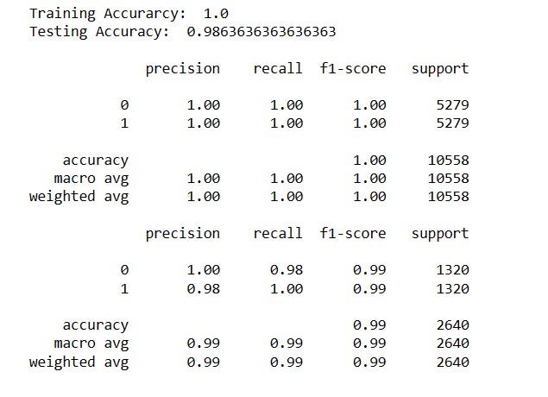
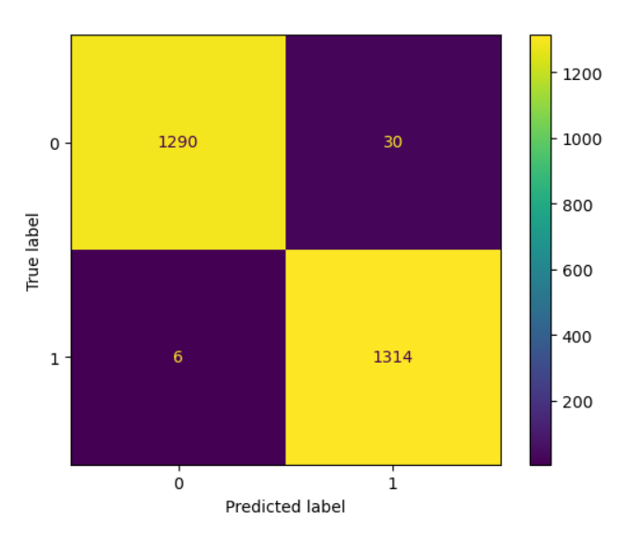
Results other than F1-Score given by XG-Boost Classifier on Balanced Dataset

Slide 35
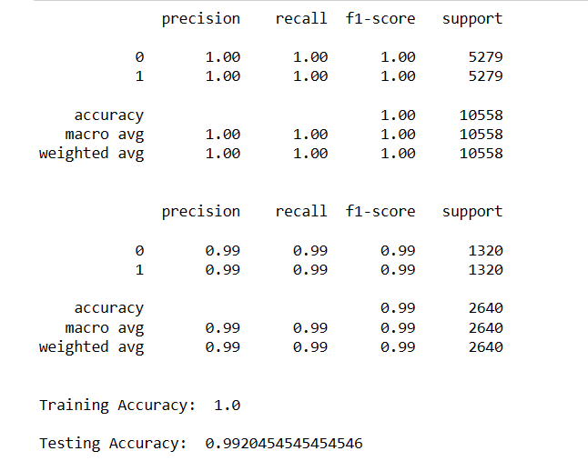
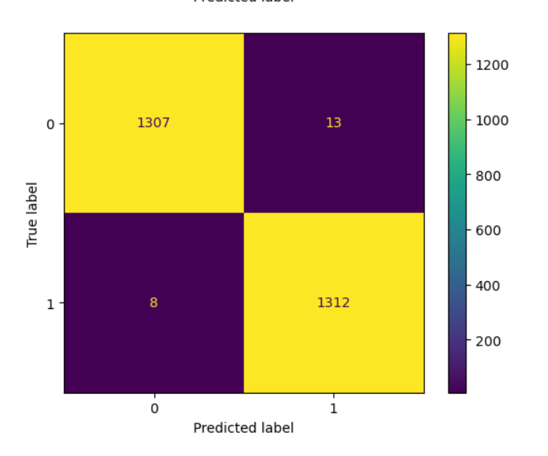
Results other than F1-Score given by Stacking Classifier on Balanced Dataset

Slide 36
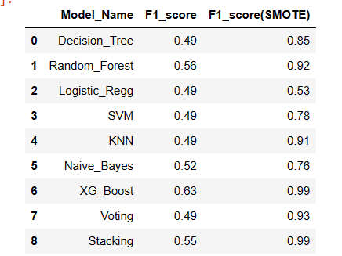
F1-Score Comparison between the models before and after applying SMOTE on the dataset

